Slide 1

Cyclistic case study
By Zac Tawfick
8/22/2024

Slide 2
Casual vs member ratio
Casual Rider Trips: 167,471
Member Rider Trips: 274,681

Slide 3
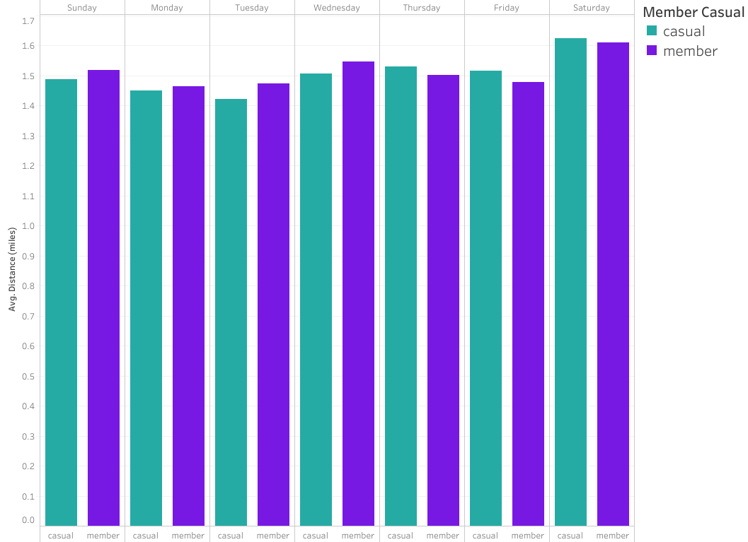
Distance vs days of week
Casual riders tend to cover more distance later in the week.
Member riders tend to cover more distance earlier in the week.
On average, both casual and member riders covered 1.5 miles per trip.

Slide 4
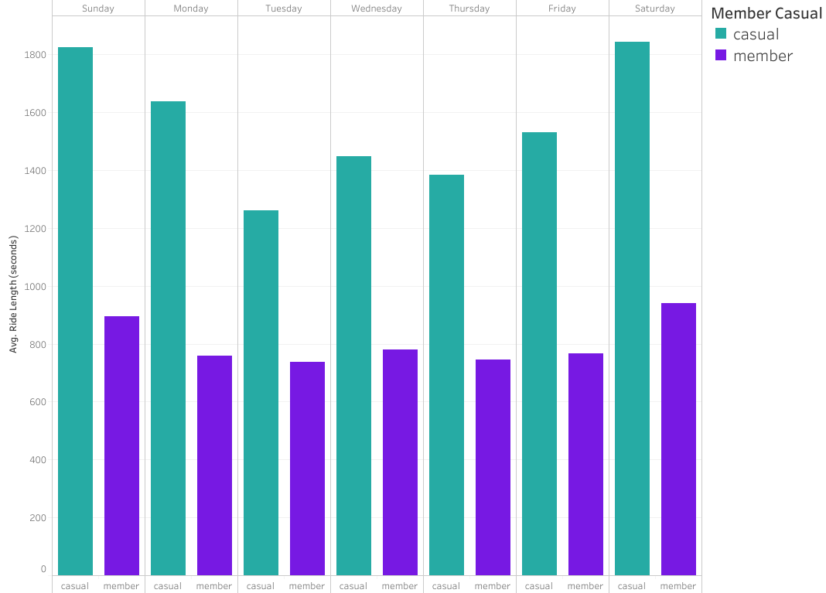
Ride length vs days of week
Casual riders tend to have longer trips than member riders.
Since, the average distance covered was the same for both, then we can conclude that member riders traveled at a higher average speed.
Both casual and member riders had longer trips on weekends compared to weekdays.

Slide 5
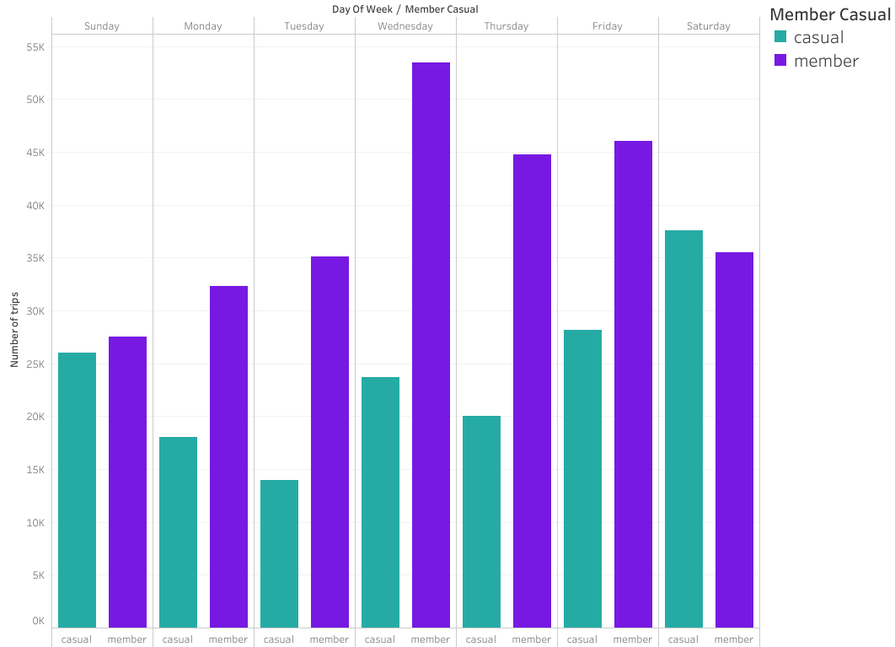
Total rides by day
Casual riders tend to ride more often on the weekends.
Member riders tend to ride more often on the last 3 weekdays.

Slide 6
Classic vs e-bikes
Casual Riders
- Mostly use classic bikes

Slide 7
Classic vs e-bikes
Member Riders
- Mostly use electric bikes

